Slide 1
Advanced Data Analysis 367-2-5461
Opher Donchin

Slide 2
Ouline of the reading (BAP Chapter 2)
A PyMC model
Writing a beta binomial model in PyMC
Sampling from the model in PyMC
The posterior
The posterior
The HDI
The ROPE
Loss functions
A Gaussian model
The model
Multi-dimensional posteriors
Posterior predictive distribution
Student’s t likelihood model
InferenceData objects
Comparison between groups
ANOVA-type model
Computations on the posterior

Slide 3
Our Outline
How to read
PyMC
Why sampling?
Sampling engines (PPLs)
A note on Guassians and priors
Analytical solution to Bayesian inference on Gaussian data
Conjugate priors and interpretation
Posterior predictive checks
Robust models
The tips example
Shapes and dimensions
InferenceData and Xarray

Slide 4
How to read

Slide 5
How to read
With colab open
Ideally a blank colab
Also ok with the chapter notebook
Run each example
Go over it line by line
Look at output
Generate the figures and make sure you understand them
Change parameters and see what happens
Do the “inspect”, “check”, “it can be seen” from the text
With a note-taking app open
Write down questions and insights

Slide 6
Howework
What to turn in
Hard homework
Different ideas

Slide 7


Slide 8
PyMC

Slide 9
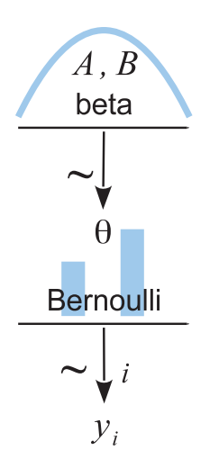
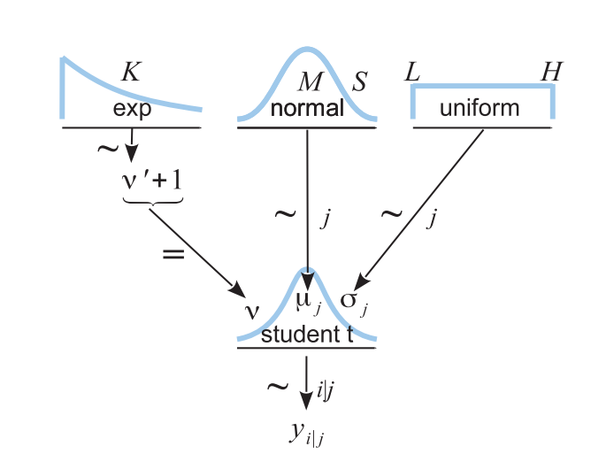
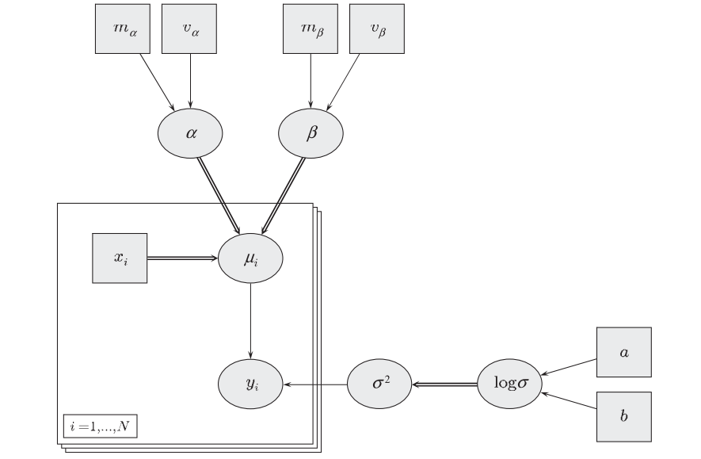
Bayesian networks / Graphical models
!

Slide 10
Why MCMC?
Analytic solutions not always available?
Must choose a likelihood with a conjugate prior
Must have a conjugate prior that fits
Grid solution often too limited
Works great for 1 parameter
Becomes quickly untenable for more than 2 or 3 parameters
We’ll learn it on one parameter, just to make things simple

Slide 11
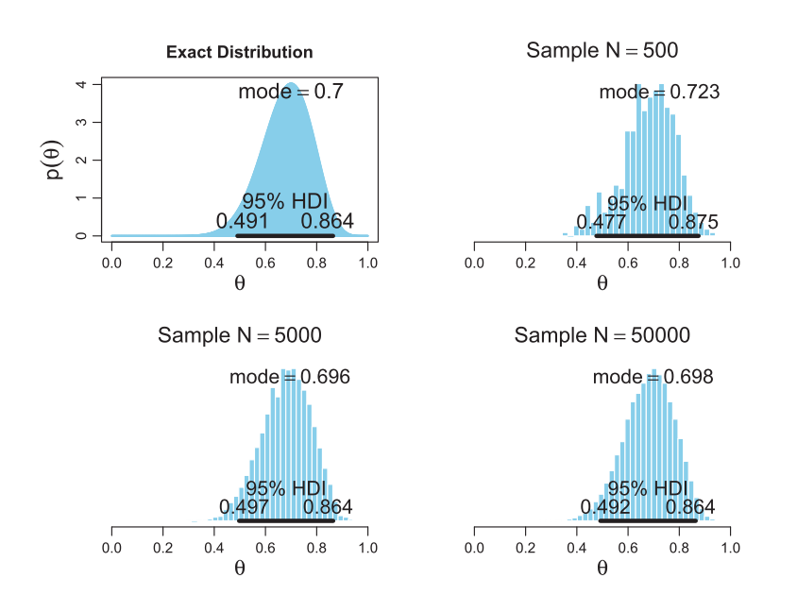
Sampling
We can sample in order to characterize a distribution

Slide 12
Sampling
We can sample in order to characterize a distribution
Larger samples give more accuracy

Slide 13
Sampling
We can sample in order to characterize a distribution
Larger samples give more accuracy
With a sample we can estimate
Mean
Mode
HDI

Slide 14
Evolution of Bayesian Sampling programs
Bugs (1989-1996)
Unix / Modula2
Sampling: 3 different samplers
WinBugs (1996-2008)
Windows / Component Pascal
Geological (2 dimensional) modelling
Doodle
OpenBugs (2004- )
Multi-platform
More flexible
Jags (2007- )
C++
Extensible
Stan (2012- )
C++
Compiles the sampler
Gradient-based methods
PyMC and many others
Python or R based

Slide 15
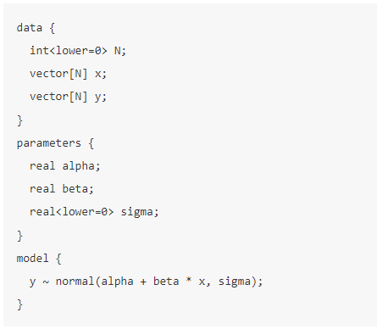
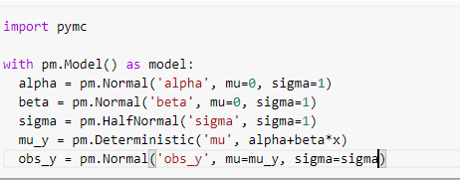
Two flavors of PPL
Separate language
Embedded in the code

Slide 16
Two flavors of PPL
Separate language
Separate model building
Model clarity
Targeted language
Cross platform
Embedded in the code
Established language
Established user base
Established ecosystem
Potential flexibility
Extensibility
Use of language features

Slide 17
The state of PyMC
PyMC3
First release 2015
Gradient based sampling
Theano back end for sampling
PyMC (v5)
Released Dec 2022
Current release 5.10.3
Colab installed 5.7.2
PyTensor backend
PyMC (v4)
Released June 2022
aesara backend
Change in syntax
Release announcement:
https://www.pymc.io/blog/v4_announcement.html

Slide 18
PyMC structure
Preliz
Specialized applications
Distributions
Samplers
Models
Arviz
Utilities
Variational Bayes
Bambi

Slide 19


Slide 20
Guassians and Guassian priors

Slide 21
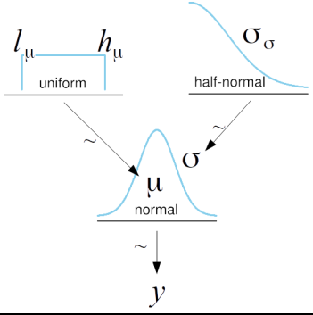
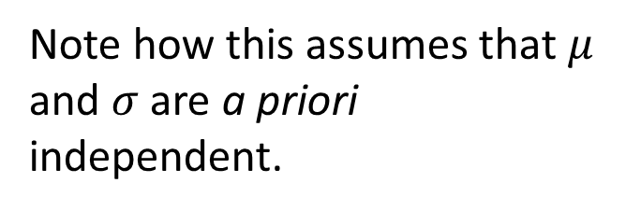
Gassians are multi-parameter
Note how this assumes that $μ$ and $σ$ are a priori independent.

Slide 22
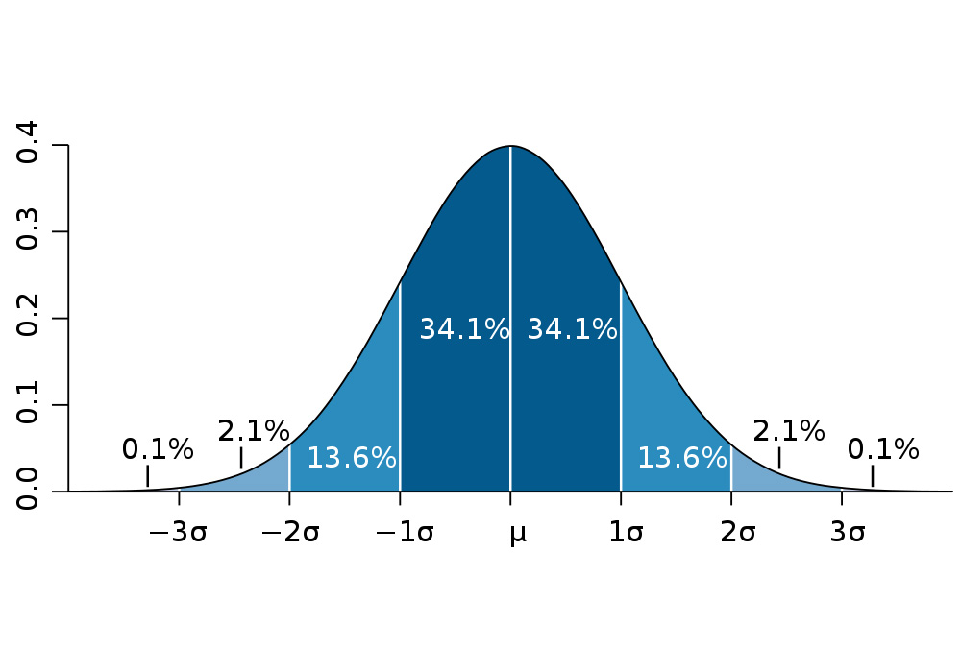
Normally distributed data

Slide 23

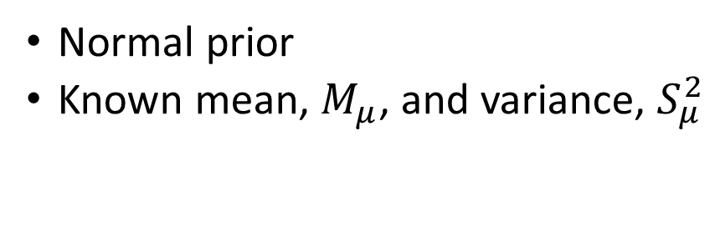
Bayesian inference
Given one data point $y$
Known data variance $S_{y}^{2}$
Unknown data mean $μ$
Normal prior
Known mean, $M_{μ}$, and variance, $S_{μ}^{2}$

Slide 24
Bayesian inference

Slide 25
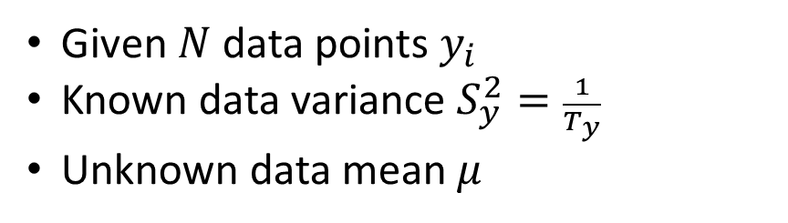
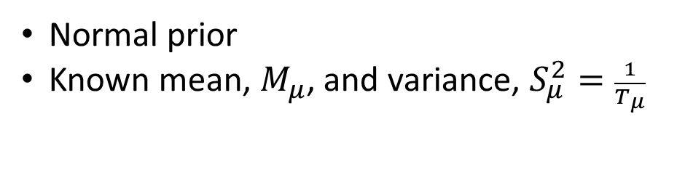
Bayesian inference
Given $N$ data points $y_{i}$
Known data variance $S_{y}^{2}=\frac{1}{T_{y}}$
Unknown data mean $μ$
Normal prior
Known mean, $M_{μ}$, and variance, $S_{μ}^{2}=\frac{1}{T_{μ}}$

Slide 26
Simplifying the likelihood

Slide 27
Simplifying the likelihood

Slide 28
Simplifying the likelihood

Slide 29
Bayesian inference
Just like having one data point

Slide 30
Precision: 1 / Variance
Posterior mean is the weighted sum of prior and likelihood means
Weighted by precision
Posterior precision is the sum of prior precision and likelihood precision

Slide 31
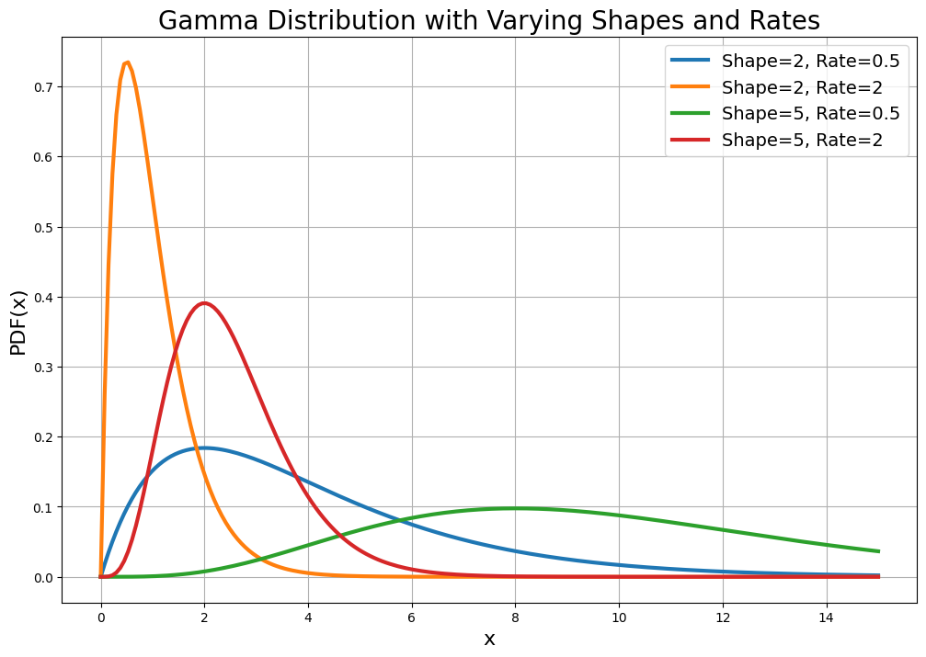
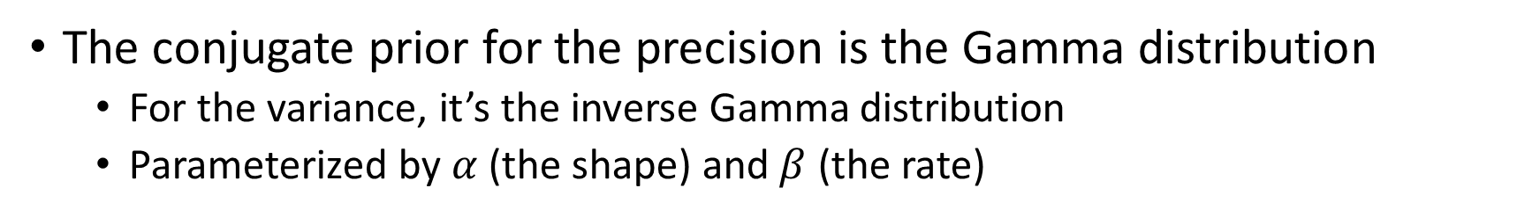
Conjugate prior for the precision / variance
The conjugate prior for the precision is the Gamma distribution
For the variance, it’s the inverse Gamma distribution
Parameterized by $α$ (the shape) and $β$ (the rate)

Slide 32
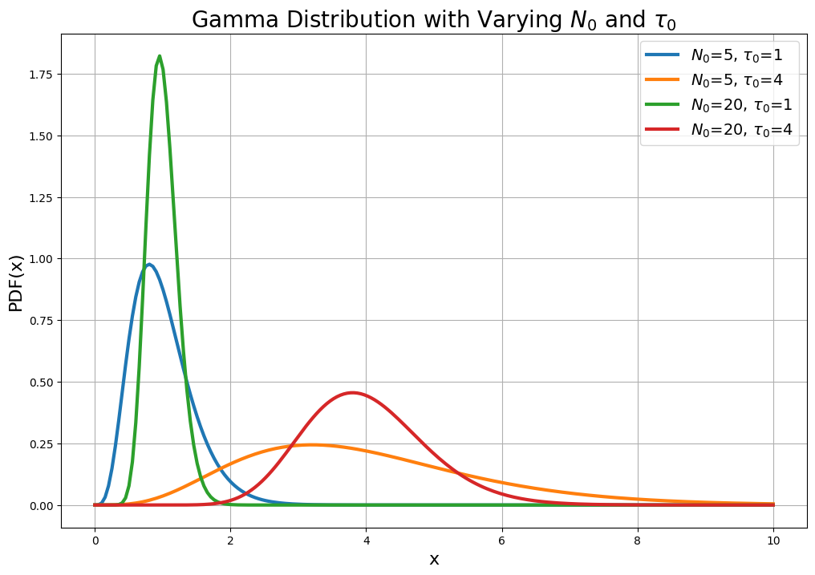
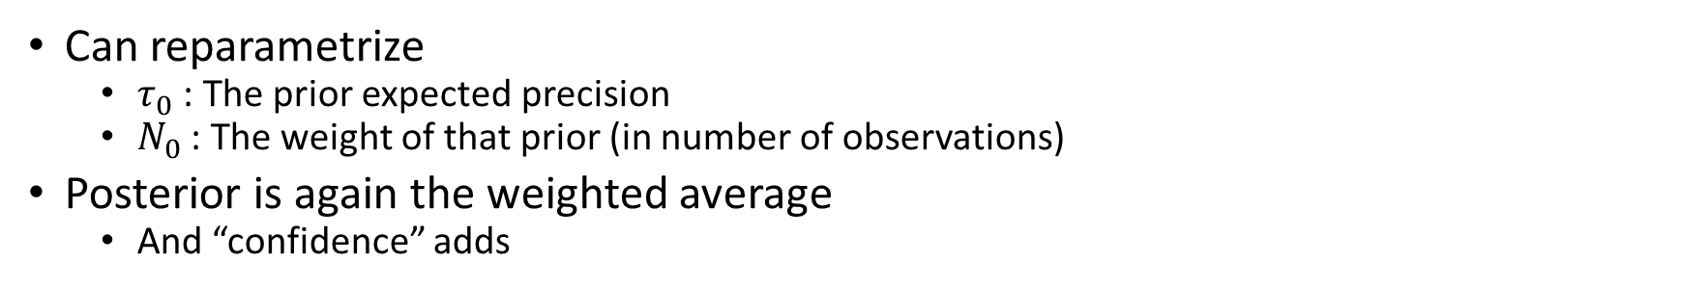
Interpretation of the Gamma prior
Can reparametrize
$τ_{0}$ : The prior expected precision
$N_{0}$ : The weight of that prior (in number of observations)
Posterior is again the weighted average
And “confidence” adds

Slide 33
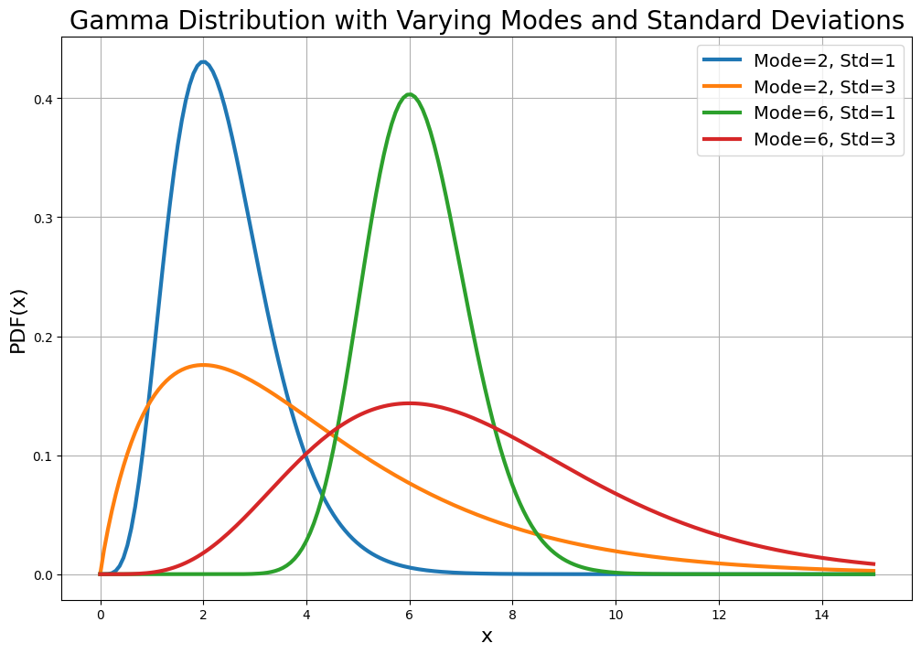
Parameterizing by mode and width
We use this as priors for standard deviation in my lab
But that’s because we didn’t know about Prezli

Slide 34
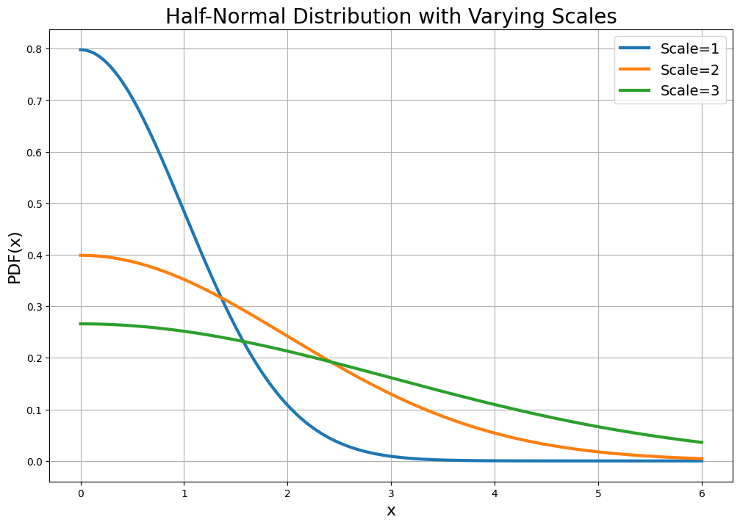
The half-normal
Parameterized only by the width

Slide 35


Slide 36
The PyMC model
with pm.Model() as model_g:
μ = pm.Uniform('μ', lower=40, upper=70)
σ = pm.HalfNormal('σ', sigma=5)
Y = pm.Normal('Y', mu=μ, sigma=σ, observed=data)
idata_g = pm.sample(random_seed=4591)

Slide 37
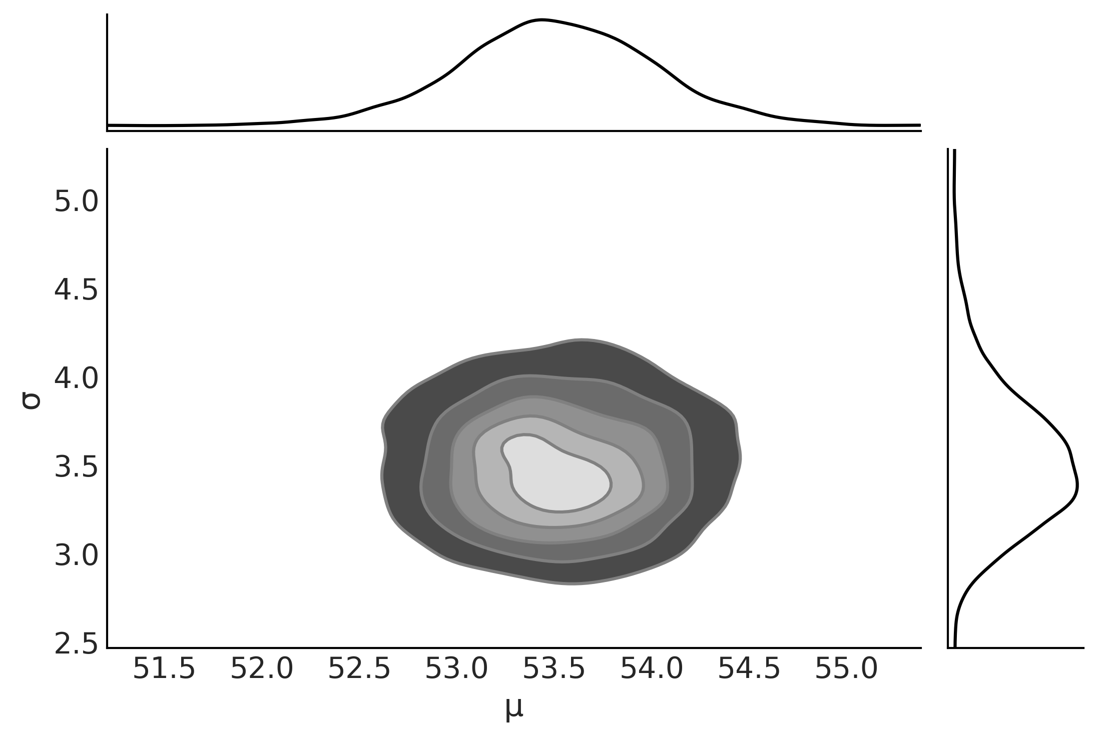
The posterior
az.plot_pair(idata_g, kind='kde', marginals=True)

Slide 38
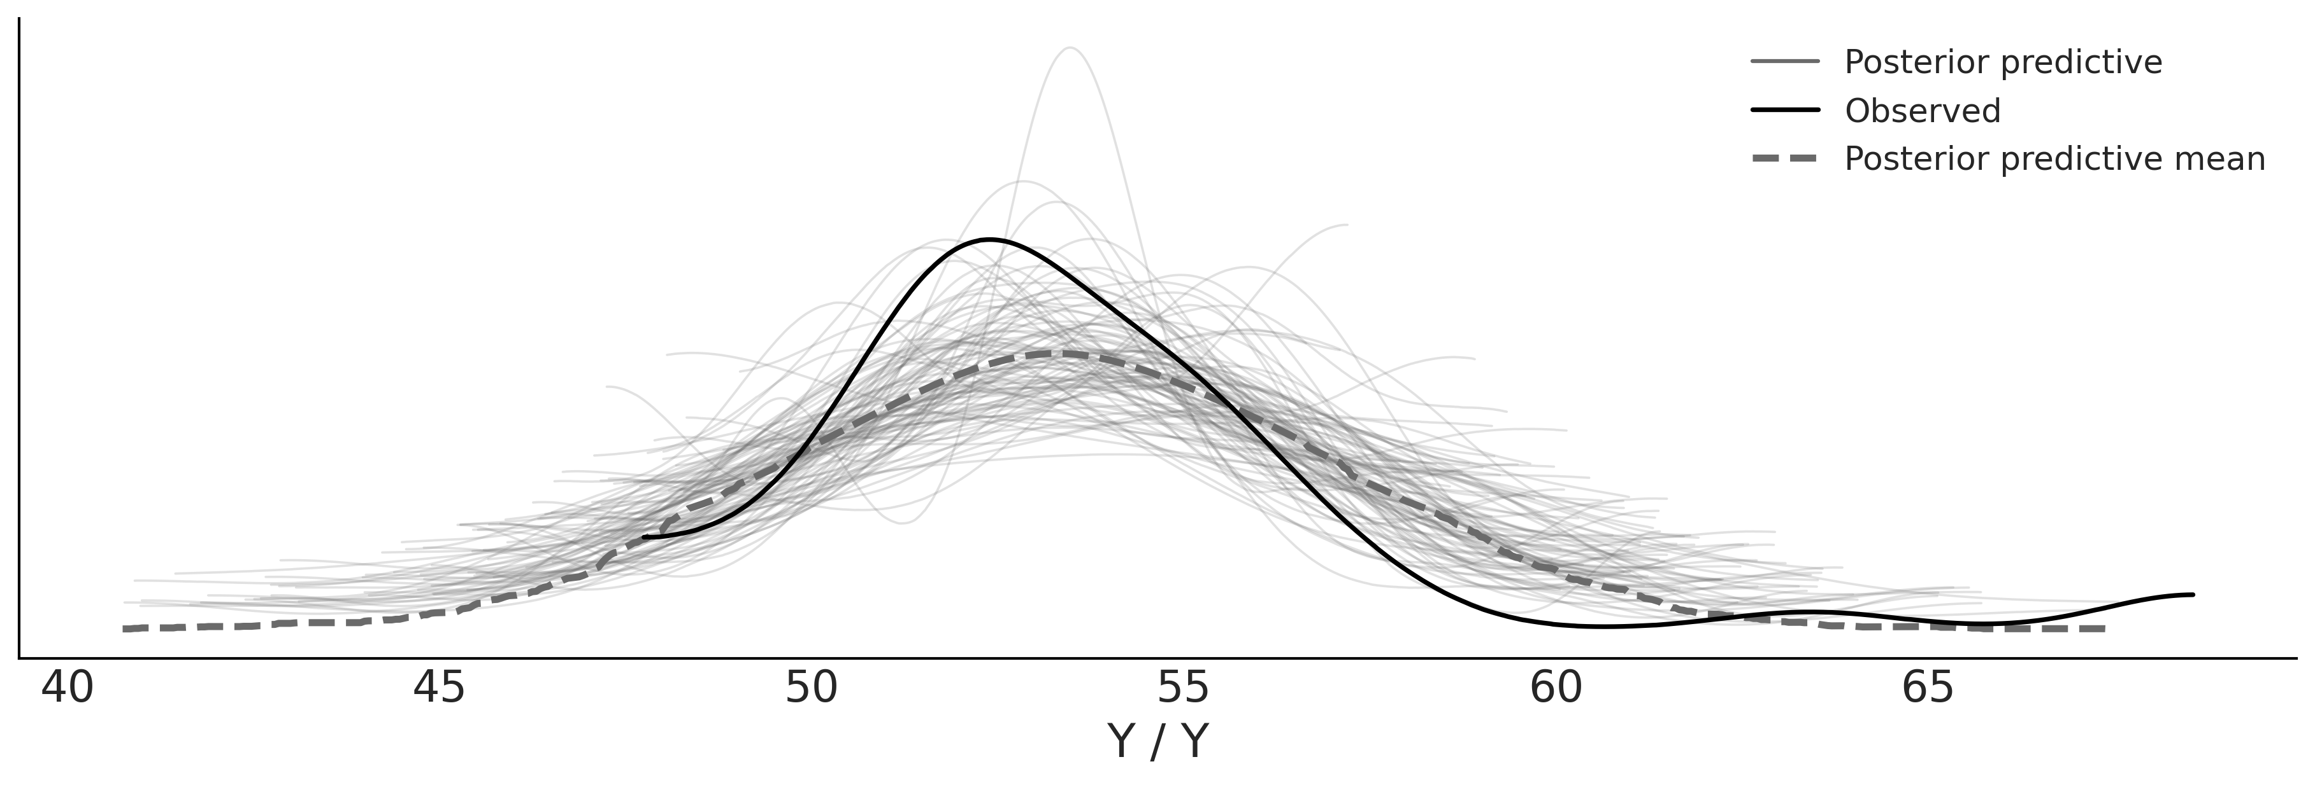
The posterior predictive
pm.sample_posterior_predictive(idata_g, model=model_g, extend_inferencedata=True)
az.plot_ppc(idata_g, num_pp_samples=100)

Slide 39
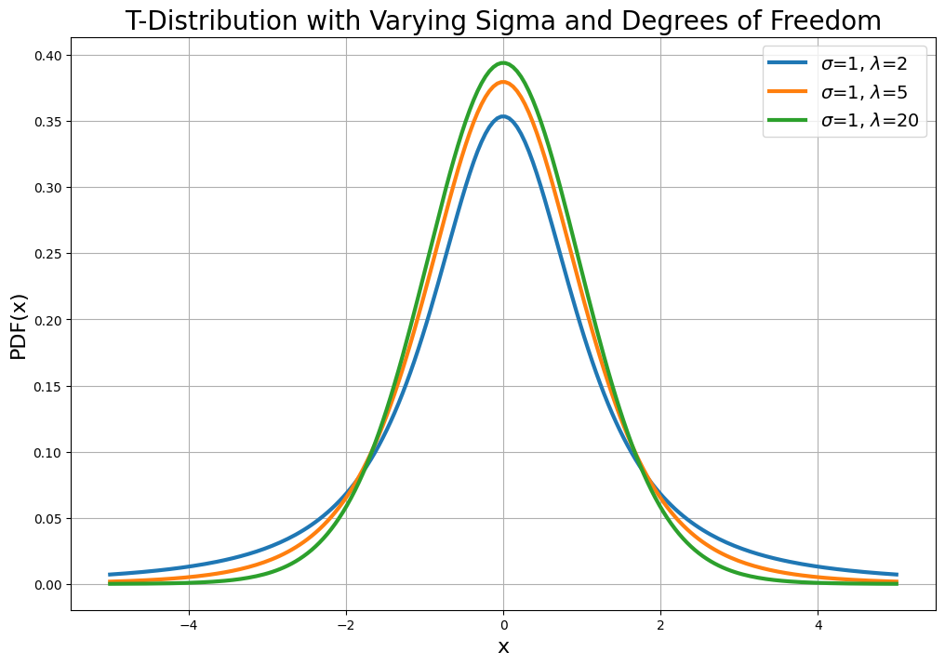
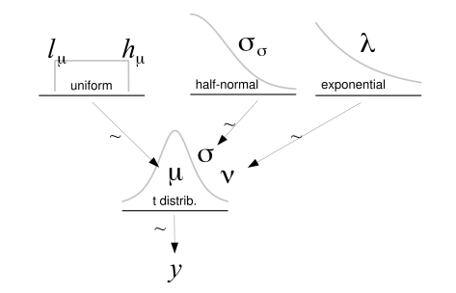
A more flexible model
Adding the kurtosis parameter makes this a “robust” analysis

Slide 40
The new model in PyMC code
with pm.Model() as model_t:
μ = pm.Uniform('μ', 40, 75)
σ = pm.HalfNormal('σ', sigma=10)
ν = pm.Exponential('ν', 1/30)
y = pm.StudentT('y', nu=ν, mu=μ, sigma=σ, observed=data)
idata_t = pm.sample(random_seed=4591)

Slide 41
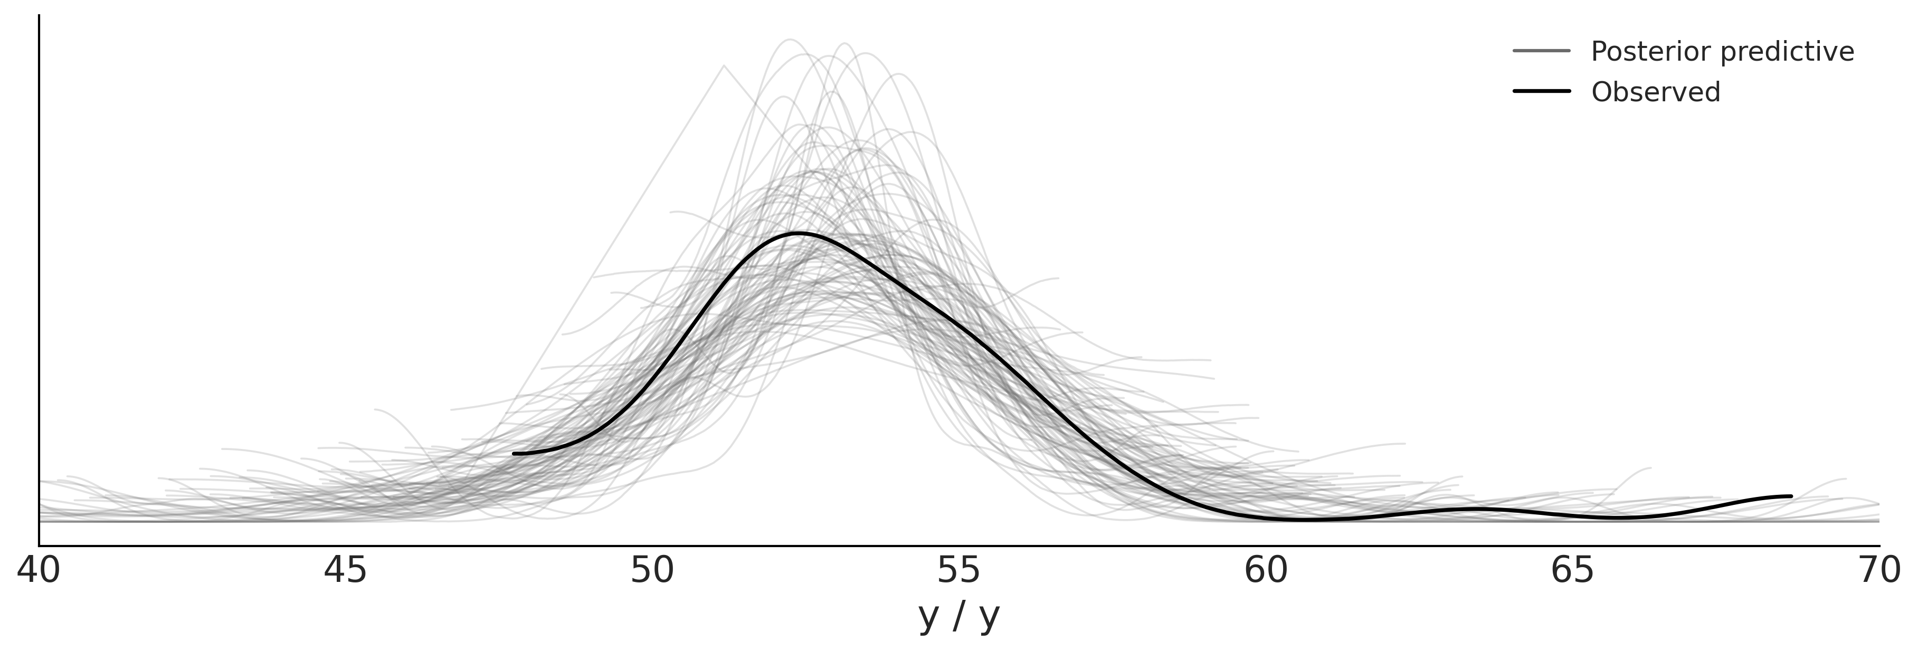
Comparing the posterior predictives
Normal
Student’s t

Slide 42
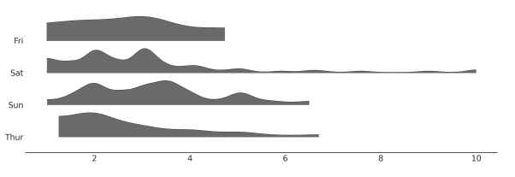
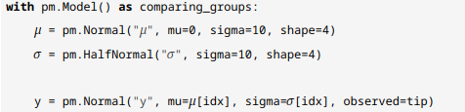
Tips
We can use “shape” to make a model with multiple parameters

Slide 43
Dimensions
Dimensions is better than shape
idx = pd.Categorical(tips["day"], categories=categories).codes
coords = {"days": categories, "days_flat":categories[idx]}
with pm.Model(coords=coords) as comparing_groups:
μ = pm.HalfNormal("μ", sigma=5, dims="days")
σ = pm.HalfNormal("σ", sigma=1, dims="days") y = pm.Gamma("y", mu=μ[idx], sigma=σ[idx], observed=tip, dims="days_flat")

Slide 44


Slide 45
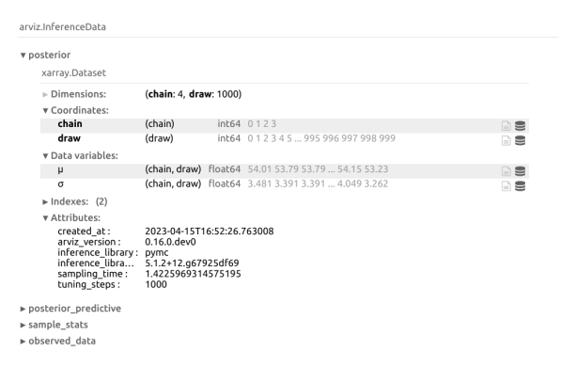
InferenceData objects
Container for the entire Bayesian analysis
Data, prior, prior predictive, posterior, posterior predictive

Slide 46
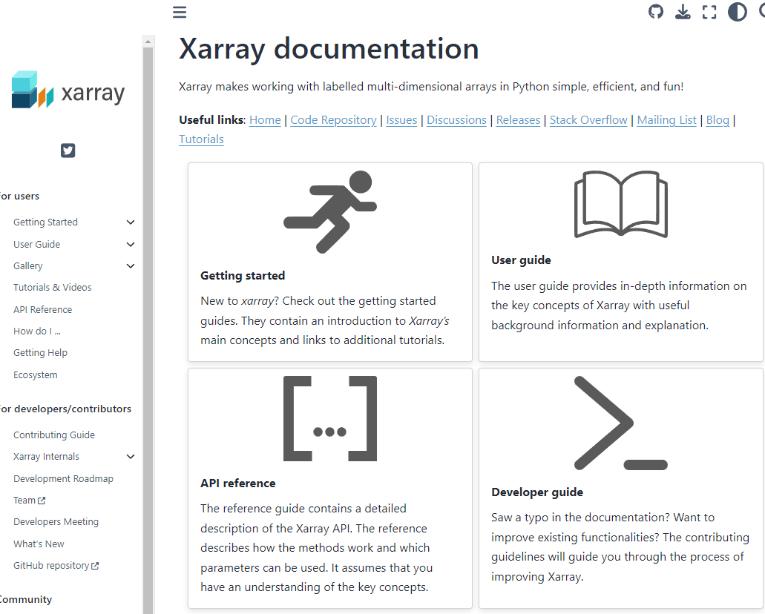
Based on the Xarray package
Multi-dimensional arrays and collections of arrays

Slide 47
Samples from a distribution are type DataArray
These are 2 dimensional but they could be more!
The dimensions are named and so are the coordinates!

Slide 48
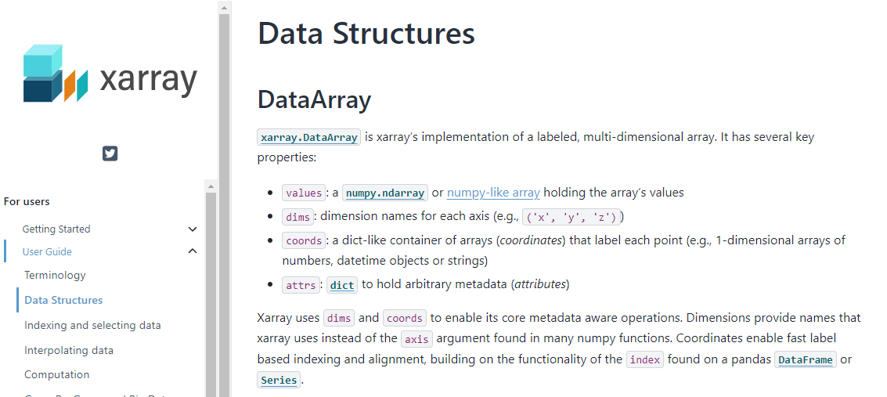

Slide 49
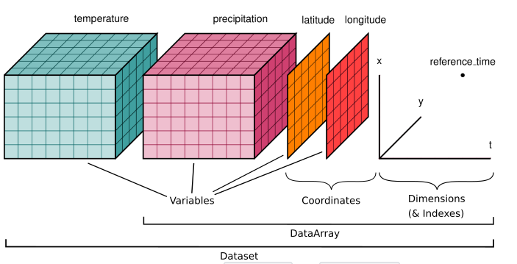
A collection of variables is of type DataSet
Like posterior or posterior_predictive
Shared dimensions and coordinates

Slide 50
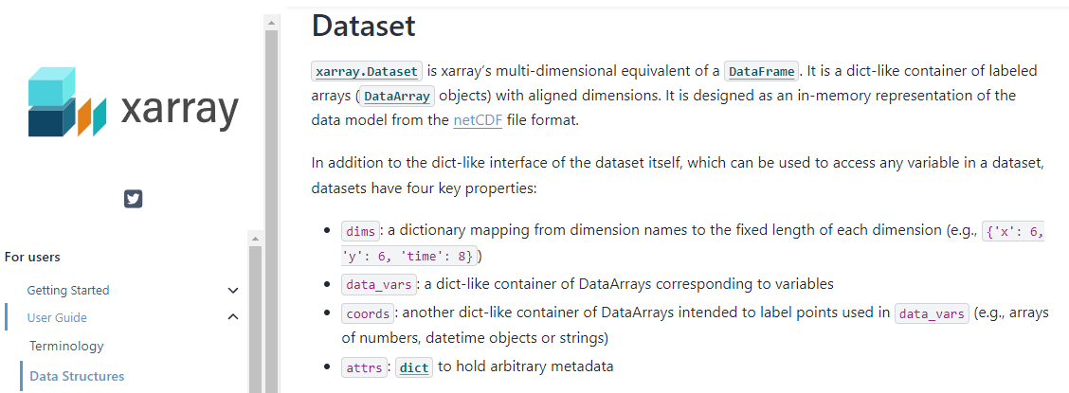

Slide 51
Structure of reading for lecture 3
BAP Chapter 10
Inference methods
The grid method
Quadratic method
Markovian methods
Monte carlo
Markov chain
Metropolis-Hastings
Hamiltonian Monte Carlo
Sequential Monte Carlo
Diagnostics
Convergence
Trace
Rank
Rhat
Correlations
ESS
MCSE
Divergences

Slide 52
Structure of reading for lecture 3
BMCP Chapter 11.9
BMCP Chapter 1
Grid inference
Metropolis hastings
Link to section on Markov chains
Hamiltonian Monte Carlo
Sequential Monte Carlo
Variational inference
Bayesian inference
Prior predictive and posterior predictive distributions
Metropolis Hastings
HDI
Beta binomial models in PyMC
Choosing priors
Conjugate priors
Objective priors
Maximum entropy priors
Weakly informative priors
Assessing priors with prior predictives

Slide 53
Structure of next weeks reading
SR Chapter 9
Good king Markov (MCMC)
Metropolis algorithm
Hamiltonian Monte Carlo
The idea
The algorithm
Limitations
ulam (HMC interface for Stan / R)
Care and feeding of your Markov Chain (Diagnostics)

